Slide 1
IPR Term 2 Week 6
T-Tests (part 3)
Dr Hayley Dewe
(Assistant Professor)

Slide 2
Announcements
Reminder to read (and use) the Discussion boards
Summative Lab report
Due 16th March
Guidance released during today’s lecture – including what to do, how it will be marked and a template
Please make sure you read these documents!
Next week (Lecture 7) is on summative Lab report writing
Q&A Drop-in
This Friday is cancelled
But I’ll stay longer after today’s lecture
Or use Discussion boards/email me

Slide 3
Clarifications on last week (t-tests part 2)
Different versions of JASP do slightly differently things / quirks (yay).
If you’re getting blank tables (e.g. no means) = switch data from ordinal to scale.
You may have to change all your data to scale manually (sometimes JASP doesn’t do it automatically (yay).
I showed you could also check Assumptions of Normality under ‘t-tests’ analysis button – but what it’ll show slightly depends on the type of t-test.
More info on the discussion board but basically report normality assumption of each condition/variable (using the main Descriptives window/button).
Reporting Assumptions It depends! If asked, yes. If not, you only tend to report assumptions that were not met – e.g. a corrected t-test, non-parametric tests were used instead, or the presence /removal of outliers etc.

Slide 4
Learning Outcomes
After the next three weeks and independent study you should be able to:
Understand the purpose of parametric t-tests (One samples, between-subjects and within-subjects) and when / why to use them.
Understand their non-parametric equivalent tests
Understand how the data are calculated and analysed.
Run all tests competently in JASP – and understand and interpret the output
Write up and interpret the results following APA standards.
Online content: Run all tests using JASP software using the ‘How to’ videos

Slide 5
Lesson Outline
Reading JASP output
Writing up t-tests (and assumptions)
Write up and interpret our t-tests results from last week
Online content: worksheet activities

Slide 6

Reporting t-tests

Slide 7

General note on published results
As you start reading more research papers – especially the results sections, you’ll likely note that different authors report statistics in various styles!
Where is alpha?
You might spend ages searching for the study’s alpha level (the significance threshold, usually p = .05) … but alas! Most authors don’t mention it at all.
That’s because:
Unless stated otherwise, everyone assumes alpha = .05.
If p < .05 → the result is considered statistically significant
Sometimes researchers use a stricter alpha level, such as .01 or .001, but this will be clearly stated (well, should be!)

Slide 8

General note on published results
You may also see something like:
all p’s < .042 or p-values < .042
This is shorthand way of reporting multiple tests at once.
It means:
They ran several related statistical tests (e.g. a few t-tests) and all of the p-values were less than or equal to .042 – which means they’re all below .05, so they are all statistically significant.
It’s used to:
keep the text tidy and concise when discussing a group of similar tests
keep things concise if you have a lot of different analyses
when these tests are not the main focus of the study (e.g. supporting or background analyses).
While shorthand is common in published papers, you should stick to full reporting in your assignments. Because we like to see it written in full - to check your understanding, and APA format

Slide 9
A note on copy/pasting from JASP
You need to write your own summary of the results: including the ‘line’ of results for the analysis test (JASP output alone isn’t sufficient)
Sometimes I may ask you to copy directly from JASP by taking a screenshot to show your output/working - start thinking about how you’d take screenshots, e.g. snipping tool.
But unless specifically asked to, you should NOT copy/paste the JASP test output into your lab reports without editing them or creating your own.
You can create from scratch or copy/paste tables and figures from JASP into your report, but you MUST edit them:
Make them APA formatted
Delete redundant / unnecessary information
Number your tables and figures
Give appropriate titles / labels / legends that match the rest of your report

Slide 10
Reporting Assumptions
You don’t typically report/explain that every assumption was checked or discuss them in detail – we only report those that matter for interpretation.
It’s assumed (and important) you’ve checked all assumptions and ran the appropriate test – they do matter, so make sure you check!
You report assumptions if:
you are specifically asked to report them (e.g. in exams)
you violated assumptions e.g., you are using a Non-Parametric test
you found/removed/kept outliers (best practice to tell the reader what you did with them)
you transformed the data, or are using any corrections (e.g. Welch)
a dissertation supervisor, reviewer, editor or colleague requests it
Often, it’s a brief sentence and a result (e.g. of a Shapiro-Wilk test)

Slide 11
Reporting Assumptions
Independent observations
It matters, but we don’t report it. We assumed you’ve checked / done this when designing and collecting data (part of good practice)
Report the Shapiro-Wilk statistic and p-value for each group. One short sentence is enough or in a descriptives table. Don’t include the graphs (distributions or histograms) for each group.
Normality
Homogeneity of variance
If applicable (for the test), include a brief sentence to say it was met or violated - report Levene’s test (value and p-value). If violated, say you used Welch’s correction.
Type of data & Outliers
Type of data: it matters, but you don’t tend to report it unless you’re asked to/required.
Outliers: one sentence stating whether there were any outliers and what you did with them.

Slide 12


Write up Checklist
Test type: type of t-test (e.g. Paired-samples t-test)
Variables: measures being explored – the IV (including the levels) and the DV
Test statistic (t – for parametric)
Df (degrees of freedom)
p-value
Significance: significant or not/non-significant (never say ‘insignificant’)
Direction (interpret): direction of the difference e.g. which group is faster/slower/higher etc.
Descriptives (mean/median) in text, table or graph
In (roughly) this order.
While there will likely be similarity between you, you need to write as independently as possible

Slide 13

Write up Checklist
Test type: type of t-test (e.g. Paired-samples t-test)
Variables: measures being explored – the IV (including the levels) and the DV
Test statistic (t – for parametric)
Df (degrees of freedom)
p-value
Significance: significant or not/non-significant (never say ‘insignificant’)
Direction (interpret): direction of the difference e.g. which group is faster/slower/higher etc.
Descriptives (mean/median) in text, table or graph
Remember, these three are written in a…
LINE of results
(like we did for the Chi-square and Correlation)

Slide 14
Write up t-tests (aka the LINE)
t(df) = XX.XX, p = .XXX, d = XX.XX
State the test you calculated
The degrees of freedom (parametric tests only)
The calculated test statistic (t-value)
The associated significance
p-value
The effect size (Cohen’s d or Rank-Biserial)
For parametric tests: use ‘t’.
For Wilcoxon use “W”. For Mann-Whitney use “U”
df = degrees of freedom in JASP test output
The test statistic (t-value) calculated from analysis. Include the sign (-) if shown.
Report the EXACT p-value (e.g., p = .042) OR p < .001 if output says that.
Cohen’s d for parametric tests.
Rank Biserial (r_{b} ) for non-parametric. Include the sign (-) if shown.
This is APA standards. And very important! Please note:
Where I have put spaces
Use 2 decimal places for test statistics (unless the statistic is a whole number) and effect sizes
Italicise letters t (W or U) and p.
If p value output p = .000, write as p < .001 (never ‘<=‘ )
No leading zeros for p, so p = .444 instead of p = 0.444
Report descriptives:
Mean/SD: 2 decimal places Median/IQR: usually whole numbers (0 decimal places)
Report Shapiro-Wilk or Levene’s:
2 decimal places, italicise ‘W’, ‘F’ and ‘p’ (p-value).

Slide 15
Write up t-tests (aka the LINE)
(Non-Parametric example)
W = XX.XX, p = .XXX, r_{b} = XX.XX
State the test you calculated
The calculated test statistic (t-value)
The associated significance
p-value
The effect size (Cohen’s d or Rank-Biserial)
No degrees of freedom
For parametric tests: use ‘t’.
For Wilcoxon use “W”. For Mann-Whitney use “U”
The test statistic (t-value) calculated from analysis. Include the sign (-) if shown.
Report the EXACT p-value (e.g., p = .042) OR p < .001 if output says that.
Cohen’s d for parametric tests.
Rank Biserial (r_{b} ) for non-parametric. Include the sign (-) if shown.

Slide 16
2. Read the jasp output:
One-Sample t-test

Slide 17

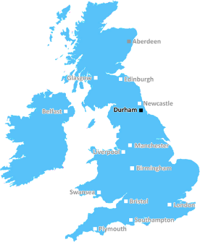
One-sample t-test
(Parametric)
Compare mean Happiness ratings of Durham University sample with a known, average UK population.
Group 1: Happiness ratings of DU students
N = 32, Mean = 20
COMPARED TO
OR, if one or more assumptions are severely violated…run a
Wilcoxon Signed Rank test
Reference: average UK happiness ratings
μ = 18 (population mean)
(Two-tailed)

Slide 18
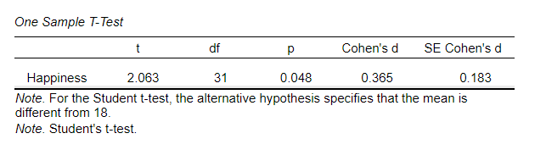
Read the output table
One-sample t-test
(Parametric)
Type of t-test
Degrees of freedom
The effect size
Fonts are for teaching purposes, don’t use colour!
The test statistic,
t-value
The p-value (significance value)
Line of results: XXX = XX.XX, X = .XXX, X = XX.XX

Slide 19
Example write up: One-Samples t-test
A one-sample t-test was conducted to examine whether there was a difference in average happiness scores (rated on a scale from 0-100) between a sample of Durham participants and the average UK population who took the new exercise class (μ = 18). All assumptions were met, including the assumption of normality (W = 0.98, p = .862). Durham students had significantly higher happiness ratings compared to the UK population, t(31) = 2.06, p = .048, d = 0.37. However, the effect size is relatively small, which suggests only a small difference – Durham students (M = 20.00, SD = 5.48) were only slightly happier than the rest of the UK population.
(remember, it’s just an example)
We don’t talk about our hypothesis in the Results section, and we assume it’s two-tailed unless told otherwise

Slide 20
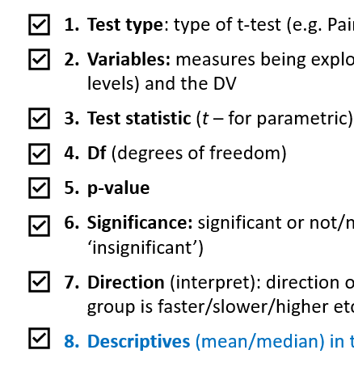
Example write up: One-Samples t-test
A one-sample t-test was conducted to examine whether there was a difference in average happiness scores (rated on a scale from 0-100) between a sample of Durham participants and the average UK population who took the new exercise class (μ = 18). All assumptions were met, including the assumption of normality (W = 0.98, p = .862). Durham students had significantly higher happiness ratings compared to the UK population, t(31) = 2.06, p = .048, d = 0.37. However, the effect size is relatively small, which suggests only a small difference – Durham students (M = 20.00, SD = 5.48) were only slightly happier than the rest of the UK population.

Slide 21
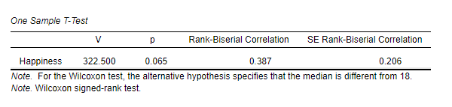
Read the output table
Wilcoxon-signed rank test
(Non-Parametric equivalent of One-sample t-test)
Type of t-test
The effect size
Remember we don’t report DF for non-parametric tests
The test statistic, W (even though it says V!)
The p-value (significance value)
Line of results: X = XX.XX, X = .XXX, X= XX.XX
Notes:
Get them to have a go first

Slide 22
Example write up: Wilcoxon-signed rank test
A Wilcoxon-signed rank test was conducted to examine whether there was a difference in happiness scores (rated on a scale from 0-100) between a sample of Durham participants and the average UK population who took the new exercise class (μ = 18). The sample violated the assumption of normality (W = 0.85, p = .006). There was a significant difference in happiness scores between the Durham sample and UK population, W = 2.06, p = .048, r_{b} = 0.37. However, the effect size is relatively small, which suggests that while the average happiness scores in our sample (Mdn = 3.50, IQR = 2.00) were higher than the UK population, this difference was marginal. It suggests that Durham participants were slightly happier than the rest of the UK population after taking the new exercise class.
(remember, it’s just an example)

Slide 23
Example write up: Wilcoxon-signed rank test
A Wilcoxon-signed rank test was conducted to examine whether there was a difference in happiness scores (rated on a scale from 0-100) between a sample of Durham participants and the average UK population who took the new exercise class (μ = 18). The sample violated the assumption of normality (W = 0.85, p = .006). There was a significant difference in happiness scores between the Durham sample and UK population, W = 2.06, p = .048, r_{b} = 0.37. However, the effect size is relatively small, which suggests that while the average happiness scores in our sample (Mdn = 3.50, IQR = 2.00) were higher than the UK population, this difference was marginal. It suggests that Durham participants were slightly happier than the rest of the UK population after taking the new exercise class.

Slide 24
3. Read the jasp output:
Paired-Samples t-test

Slide 25
Paired-samples t-test
(Parametric)
Compare participants average happiness ratings after 1 month of exercise with their happiness ratings after 6 months of exercise.
Group 1: Happiness ratings after 1 month of exercise
N = 16, Mean = 19
COMPARED TO
OR, if one or more assumptions are severely violated…run a
Wilcoxon Signed Rank test
Group 1: Happiness ratings after 6 months of exercise
N = 16, Mean = 21
(One-tailed, 1M < 6M)

Slide 26
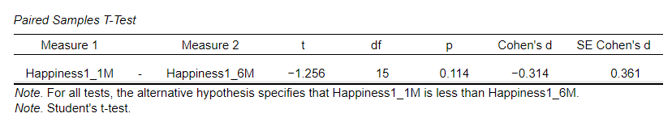
Read the output table
Paired-samples t-test
(Parametric)
The effect size
Type of t-test
Degrees of freedom
The test statistic,
t-value
The p-value (significance value)
Line of results: XXX = XX.XX, X = .XXX, X = XX.XX

Slide 27
Example write up: Paired-samples t-test
A paired samples t-test (one-tailed) was used to examine whether there was a difference in average happiness scores (scale from 0-100) for participants taking part in an Aerobics exercise class after 1 month compared to after 6 months. The assumption of normality was met for happiness at 1 month (W = 0.96, p = .729) and happiness at 6 months (W = 0.94, p = .437). There was no significant difference between happiness scores at 1 month (M = 18.56, SD = 2.78) and happiness scores at 6 months (M = 20.94, SD = 7.06), t(15) = -1.26, p = .114, d = -0.31. It suggests the duration of participation in the Aerobics class did not affect happiness ratings between the two time points.
(an example…)
Remember we don’t refer to our hypothesis. We assume two-tailed.
But for one-tailed test: write ‘one-tailed’, don’t write the whole hypothesis in full.
If you had lots of tests, you could briefly mention the comparison being analysed (e.g. if X > Y).

Slide 28
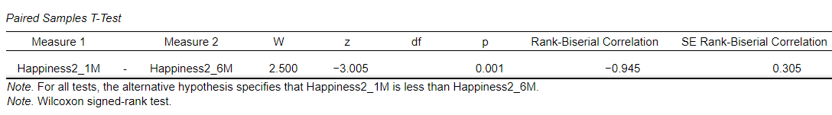
Read the output table
Wilcoxon-signed rank test
(Non-Parametric equivalent of One-sample t-test)
The effect size
Type of t-test
The test statistic
W (Wilcoxon)
The p-value (significance value)
Line of results: X = XX.XX, X = .XXX, X = XX.XX

Slide 29
Example write up: Wilcoxon-signed rank test
The assumption of normality was violated for happiness at 6 months (W = 0.86, p = .018) and was borderline for happiness at 1 month (W = 0.89, p = .051), so a non-parametric test was used. A one-tailed Wilcoxon-signed rank test examined whether median happiness scores (from 0-100) differed between 1 month and 6 months of participants taking part in Aerobic exercise. There was a significant difference in happiness scores (W = 2.50, p = .001, r_{b} = -0.95), where happiness at 6 months (Mdn = 3.50, IQR = 2.00) was higher than at 1 month (Mdn = 1.50, IQR 1.00). It indicates a large effect and suggests that happiness ratings increased over time with continued participation.
(an example…slightly different order, but all still there)

Slide 30
4. Read the jasp output:
independent-Samples t-test

Slide 31

Independent-samples t-test
(Parametric)
Compare average happiness ratings of Group A who completed Aerobic exercise with happiness ratings of Group 2, who completed Strength exercise.
Group 1: Happiness ratings of those who did Aerobic exercise
N = 16, Mean = 17
COMPARED TO
OR, if one or more assumptions are severely violated…run a
Mann-Whitney U test
Group 2: Happiness ratings of those who did Strength exercise
N = 16, Mean = 23
(Two-tailed)

Slide 32
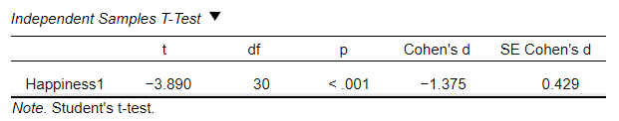
Read the output table
Independent-samples t-test
(Parametric)
Degrees of freedom
The effect size
Type of t-test
The test statistic,
t-value
The p-value (significance value)
Line of results: XXX = XX.XX, X = .XXX, X = XX.XX

Slide 33
Example write up: Independent-samples t-test
An independent samples t-test was used to examine whether there was a difference in average happiness scores (from 0-100) between two groups of participants who took part in different exercise (Aerobics vs Strength). The assumption of normality was met for both the Aerobics (W = 0.98, p = .971) and the Strength (W = 0.95, p = .530) group, and Levene’s test was non-significant, indicating homogeneity of variance (F = 0.42, p = .522). The Strength exercise group had significantly higher happiness ratings compared to the Aerobics exercise group, t(30) = -3.89, p < .001, d = 1.38. The effect is large and suggests that participants in the Strength training (M = 16.88, SD = 4.11) class were happier than those in the Aerobics class (M = 23.13, SD = 4.94).
(an example…)

Slide 34
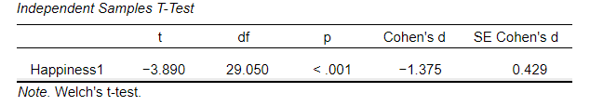
Example write up: Welch-corrected Independent t-test
If you only violated the assumption of homogeneity (Levene’s test was significant) you could run a Welch corrected independent samples t-test.
A Welch-corrected independent samples t-test was used to examine whether there was a difference in average happiness scores (from 0-100) between two groups of participants who took part in different exercise (Aerobics vs Strength). The assumption of normality was met for both the Aerobics (W = 0.98, p = .971) and the Strength (W = 0.95, p = .530) group, and Levene’s test was non-significant, indicating homogeneity of variance (F = 0.42, p = .522). The Strength exercise group had significantly higher happiness ratings compared to the Aerobics exercise group, t(29.05) = -3.89, p < .001, d = 1.38. The effect is large and suggests that participants in the Strength training (M = 16.88, SD = 4.11) class were happier than those in the Aerobics class (M = 23.13, SD = 4.94).

Slide 35
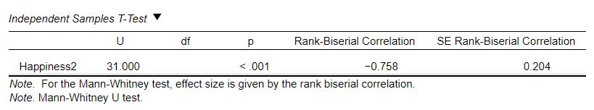
Read the output table
Mann-Whitney U test
(Non-Parametric equivalent of Independent-samples t-test)
The effect size
Type of t-test
The test statistic,
t-value
The p-value (significance value)
Line of results: X = XX.XX, X = .XXX, X = XX.XX

Slide 36
Example write up: Mann-Whitney U test
The assumption of normality was violated for the Aerobic exercise group (W = 0.70, p < .001) but was met for the Strength group (W = 0.90, p = .095). The Levene’s test of homogeneity of variance was also violated (F = 7.01, p = .013), so a Mann-Whitney U test was used to examine differences in happiness ratings (from 0-100) across the two exercise groups. The Strength exercise group (Mdn = 3.00, IQR = 2.25) had significantly higher happiness ratings compared to the Aerobics exercise group (Mdn = 1.00, IQR = 1.00), U = 31.00, p < .001, r_{b} = -0.76, indicating a large effect. This suggests that participants taking part in Strength training exercise were happier than those completing the Aerobics class.
(an example…)

Slide 37

ONLINE CONTENT
Complete the Activity Worksheet
It assesses your understanding of experimental design (different types of t-tests) and how to interpret different results.

